Slide 1
Machine Learning and the NBA Draft UNC Data Analytics Boot Camp Project 3 Results
© Copyright 2020
Authors Alexander Brown, Matthew Fahys, Spencer Harrison, Phil Lowden

Slide 2
Machine Learning and the NBA Draft
Purpose: create a machine learning model to suggest the best NBA draft prospects using:
College basketball stats, including strength of schedule.
Combine (physical tests) results.
First three years of NBA stats.
Goal: have the model determine the likelihood of a to-be-drafted player to become an All-Star, Starter, Role Player, or Bust.
Training/testing data: 2000 – 2014 seasons
Prediction data: 2015 - 2018 seasons
Spencer

Slide 3
Technologies Used
Python (Jupyter Notebooks) with pandas
APIs/libraries:
sportsreference.ncaab API - NCAA stats: % pip install basketball-reference-web-scrape
BeautifulSoup – web-scraping: from bs4 import BeautifulSoup
splinter – web-scraping: from splinter import Browser
sklearn – machine learning: from sklearn import tree
graphviz – visualization of tree: from sklearn.tree import export_graphviz
Tableau – interactive visualization of data
Random forest:
In (1): from sklearn.ensemble import RandomForestClassifier
rf = RandomForestClassifier(n_estimators = 500)
rf = rf.fit(X_train, y_train)
rf.score(X_test, y_test)
Out (1): 0.49411764705882355
Alex

Slide 4
Methodology
Determine a goal: help NBA teams make best draft picks
Look for similar studies: ESPN (https://www.espn.com/nba/story/_/id/23771351/espn-draft-analytics-model-makes-nba-draft-projections)
Choose model type: random forest (classification)
Define classifications: All-Star (best), Starter (better), Role Player (good), Bust (underperformers) - based on Box Plus-Minus stat
Decide player scope: based on minutes played, etc.
Determine features (inputs): went from 89 possible to 52 actually used (see next slide for details)
Locate, download/scrape, clean, and join data sources (see later slides for details):
NBA performance (of drafted players)
NBA draft results and combine scores (combines = physical ability tests)
NCAA stats (of players in the draft)
In [2]: # read in datasets
nba_class = pd.read_csv('../data/nba_data_bpm_classified.csv’)
nba_draft = pd.read_csv('../data/nba_draft.csv’)
ncaa_stats = pd.read_csv('../data/ncaa_stats.csv’
Key limitations:
Some important data not available (e.g. scouting reports)
No way to include players who didn’t play in college (high school/overseas)
Spencer

Slide 5
Features
Index(['lane_agility', 'sprint', 'max_leap', 'body_fat’,
'height_shoes', 'wingspan', 'assists', 'block_percentage’,
'blocks', 'free_throw_attempt', 'free_throw_percentage’,
'minutes_played', 'personal_fouls', 'steals’,
'three_point_attempts', 'three_point_percentage’,
'total_rebound_percentage', 'total_rebounds’,
'turnover_percentage', 'turnovers', 'two_point_attempts’,
'two_point_percentage', 'win_shares', 'position_C’,
'position_F', 'position_G', 'conference_aac', 'conference_acc’,
'conference_america-east', 'conference_atlantic-10’,
'conference_big-12', 'conference_big-east', 'conference_big-sky’,
'conference_big-ten', 'conference_colonial', 'conference_cusa’,
'conference_horizon', 'conference_maac', 'conference_mac’,
'conference_meac', 'conference_mvc', 'conference_mwc', 'conference_ovc’,
'conference_pac-10', 'conference_pac-12', 'conference_patriot’,
'conference_sec’, 'conference_southern', 'conference_summit’,
'conference_sun-belt', 'conference_wac', 'conference_wcc'], dtype='object')
Phil

Slide 6
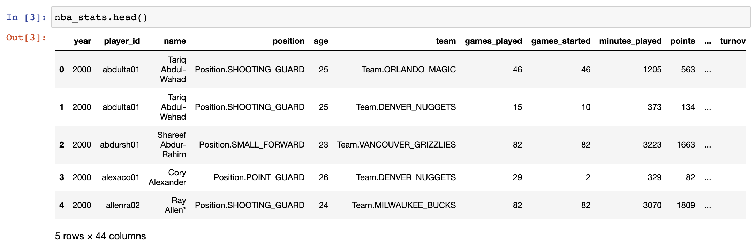
NBA Data Set
In [8]: print(nba_stats["classification"].value_counts())
Starter 3308
Role Player 3008
Exclude 2957
All-Star 682
Bust 525
Name: classification, dtype: int64
Alex

Slide 7
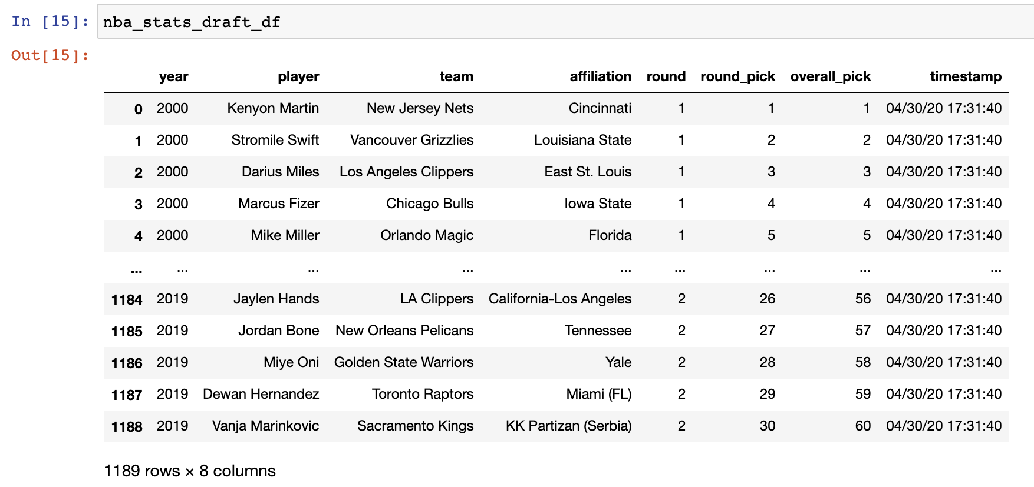
NBA Draft/Combine Data Set
In [1]: from splinter import Browser
from bs4 import BeautifulSoup
In [4]: def scrape_nba_stats_draft(ts):
browser = init_browser()
url = "https://stats.nba.com/draft/history/"
browser.visit(url)
Phil

Slide 8
NCAA Data Set
In [1]: from sportsreference.ncaab.roster import Player
from sportsreference.ncaab.roster import Roster
In [6]: final_df = pd.DataFrame(list(zip(assist_percentage, assists, box_plus_minus,
block_percentage,blocks, conference, defensive_rebound_percentage, defensive_rebounds,
effective_field_goal_percentage, field_goal_attempts, field_goals, free_throw_attempt_rate,
free_throw_attempts, free_throw_percentage, free_throws, minutes_played, name,
offensive_rebound_percentage, offensive_rebounds, personal_fouls, player_id, points,
steal_percentage, steals, three_point_attempt_rate, three_point_attempts, three_point_percentage,
three_pointers, total_rebound_percentage, total_rebounds, true_shooting_percentage
turnover_percentage, turnovers, two_point_attempts, two_point_percentage, two_pointers,
usage_percentage, win_shares)), columns=['assist_percentage', 'assists', 'box_plus_minus’,
'block_percentage', 'blocks', 'conference', 'defensive_rebound_percentage', 'defensive_rebounds’,
'effective_field_goal_percentage', 'field_goal_attempts', 'field_goals’,
'free_throw_attempt_rate', 'free_throw_attempt', 'free_throw_percentage', 'free_throws’,
'minutes_played’, 'name', 'offensive_rebound_percentage', 'offensive_rebounds', 'personal_fouls’,
'player_id', 'points’, 'steal_percentage', 'steals', 'three_point_attempt_rate’,
'three_point_attempts’, 'three_point_percentage', 'three_pointers', 'total_rebound_percentage’,
'total_rebounds’, 'true_shooting_percentage', 'turnover_percentage', 'turnovers’,
'two_point_attempts’, 'two_point_percentage’, 'two_pointers', 'usage_percentage', 'win_shares’])
Matt

Slide 9
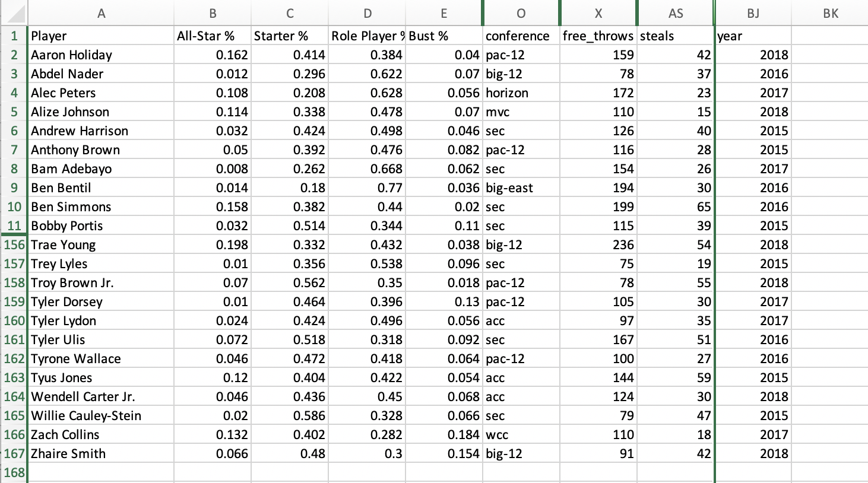
Results: Model Output
Spencer

Slide 10
Results (cont.): Feature Importance
[In 8]: sorted(zip(rf.feature_importances_, feature_names), reverse=True)
[Out 8]: [(0.06943119367724125, 'steals’),
(0.04995204927472601, 'two_point_attempts’),
(0.04593638829964517, 'three_point_percentage’),
(0.045877873541169484, 'assists’),
(0.04535229995754153, 'block_percentage’),
...
(0.03435108201026965, 'lane_agility’),
(0.03434277464030541, 'personal_fouls’),
(0.03332264837196741, 'blocks’),
...
(5.8977793075605426e-05, 'conference_america-east’),
(3.39736740270657e-05, 'conference_mvc’),
(0.0, 'conference_summit’),
(0.0, 'conference_maac’)]
Spencer

Slide 11
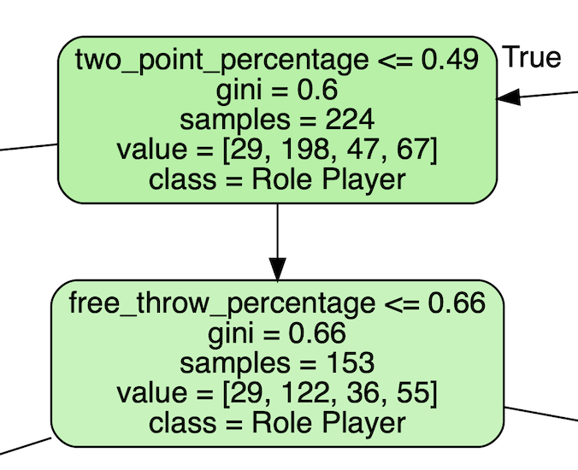
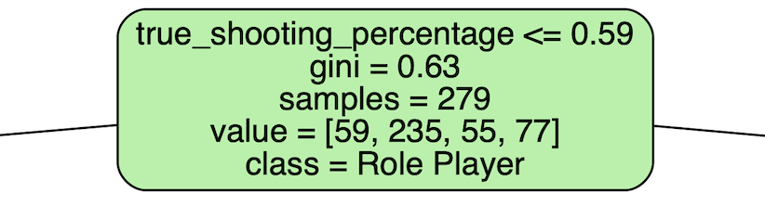
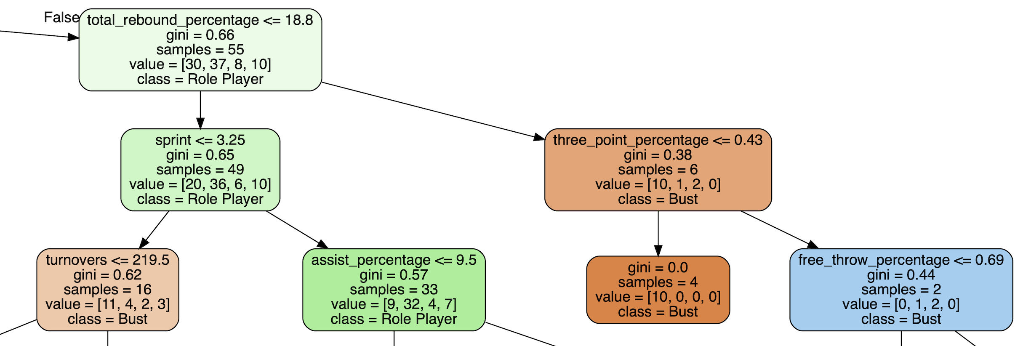
Results (cont.): Graphviz
Matt

Slide 12
Tableau Interactive Demo: Results Visualization

Slide 13
Thank You!

